Slide 1
Identifying Spam using Natural Language Processing and Machine Learning
Peter Ilhardt

Slide 2
The Problem
Spam makes up around 87% of all e-mails sent with an average volume of about 480 billion messages per day (Talos Intel.)
Spam is estimated to cost $130 billion per year worldwide in lost productivity and energy, including $20 billion spent combating (Forbes)
How well can we classify news articles as spam or valid?

Slide 3

The Data
631 full-text articles (JSON) from 31 news sources, along with URLs, dates, and authors
A “blacklist” of 49 flagged news agencies’ base URLs was also provided
assetsstock.com

Slide 4
The Approach
Load and Clean Data
Text Preprocessing
Tokenization
Exploratory Data Analysis
Topic Modeling
Cluster Analysis
Process Data
Bag of Words Model
Dimensionality Reduction
Build Models
Binary Classification
Evaluate and Compare
Model Diagnostics
Ensembling
Feature Importance

Slide 5
The Tools
Language: Python
Packages:
Scikit-Learn
NumPy
Pandas
Matplotlib
Seaborn
Json
re (regular expressions)
Gensim

Slide 6
Text Preprocessing
Text data is messy!
Cleaning steps:
Remove numbers and words with numbers
Remove punctuation
Make letters lowercase
Remove non-English language characters
Remove one- and two-letter words
Remove newline characters and strip whitespace
Remove “stop words” (little semantic value)
Tokenization

Slide 7
Raw Text:
CNBC\'s Jim Cramer welcomed Dropbox\'s successful initial public offering on Friday as a reminder that even in a sell-off, good things can still happen.\n\nShares of the cloud-based data storage company closed up over 35 percent after its first day of trading, at $28.48 a share, well above the company\'s stated price of $21.
Clean Text:
cnbc jim cramer welcomed dropbox successful initial public offering friday reminder that even sell off good things can still happen shares the cloud based data storage company closed over percent after its first day trading share well above the company stated price

Slide 8
The Bag of Words Approach

Slide 9
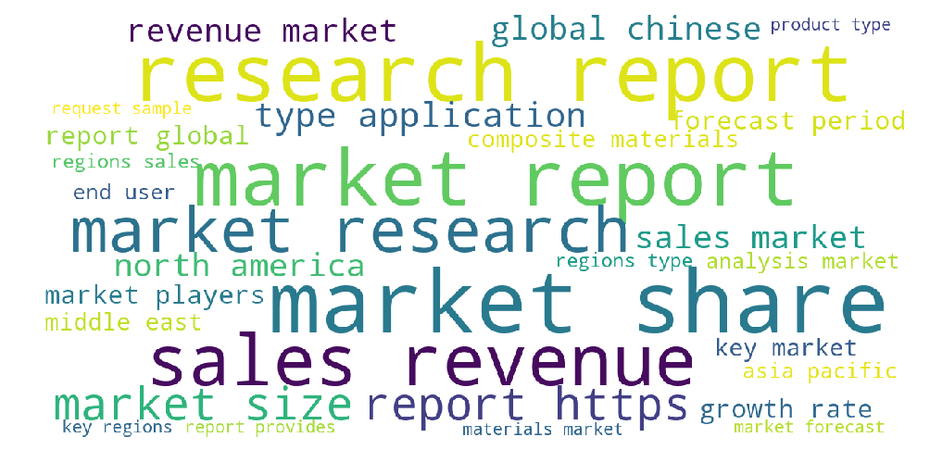
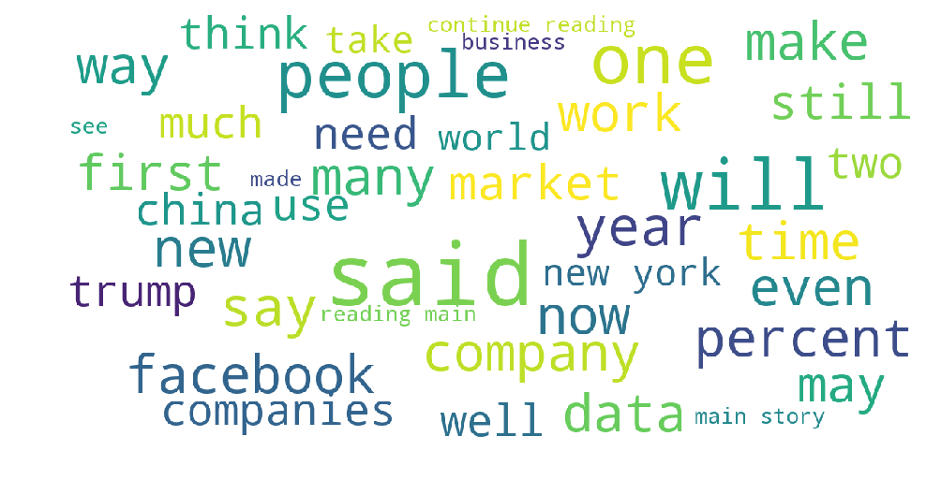
What Words Does Spam Tend to Use?
Spam
Valid

Slide 10
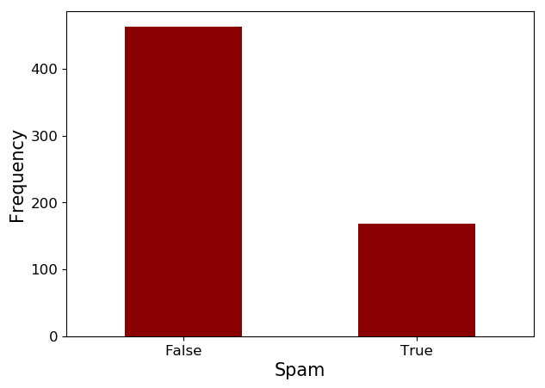
Class Imbalance

Slide 11
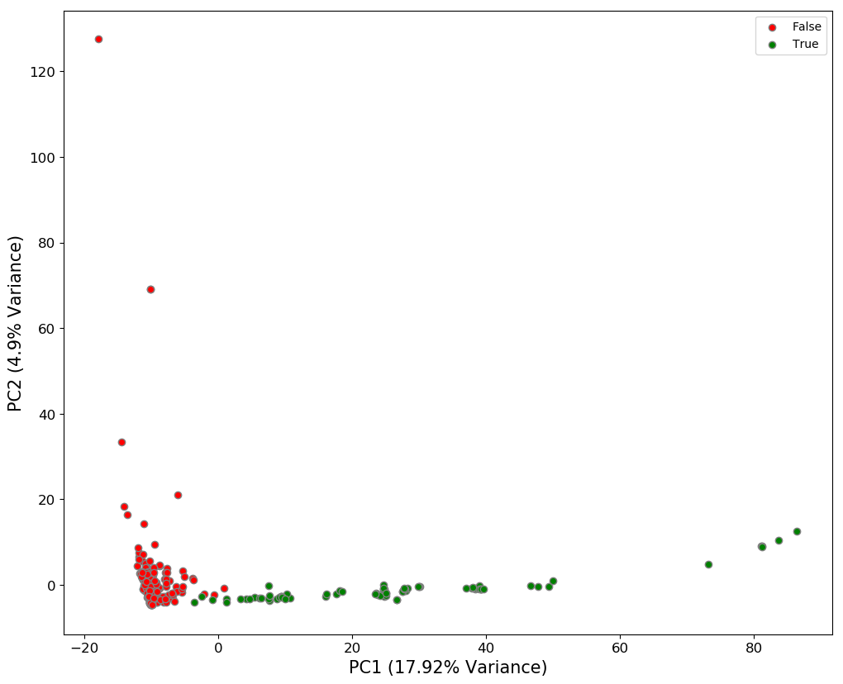
Principal Components Analysis (PCA)
Valid
Spam
The document-term matrix has >20,000 features!
PCA reduces the dimensions by generating new features that capture the most variance
This allows us to “project” the data to a lower-dimensional space and visualize clustering behavior
PC 1 here appears to separate spam and valid articles well

Slide 12
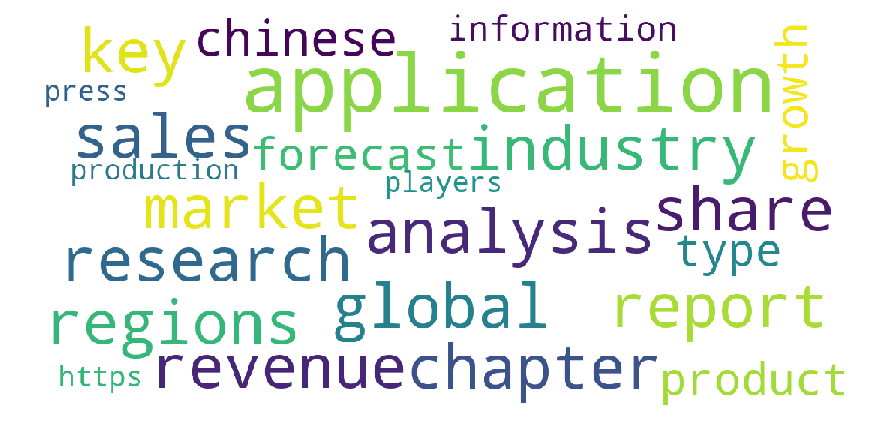
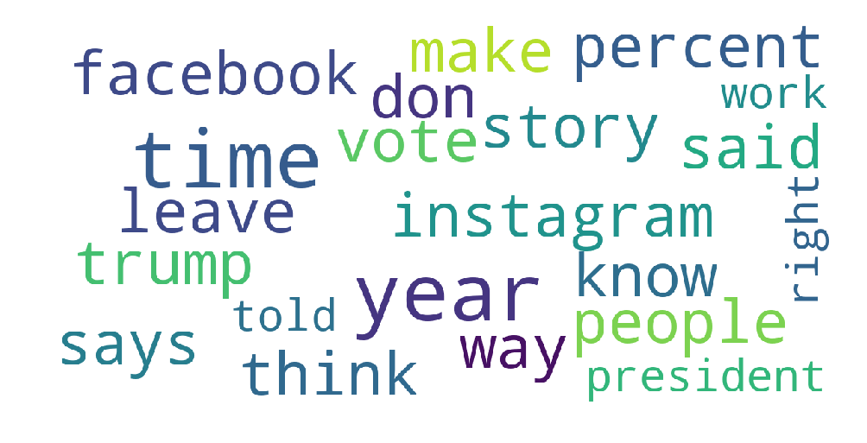
Principal Components Analysis Reveals Important Words
Positive Loadings
Negative Loadings

Slide 13
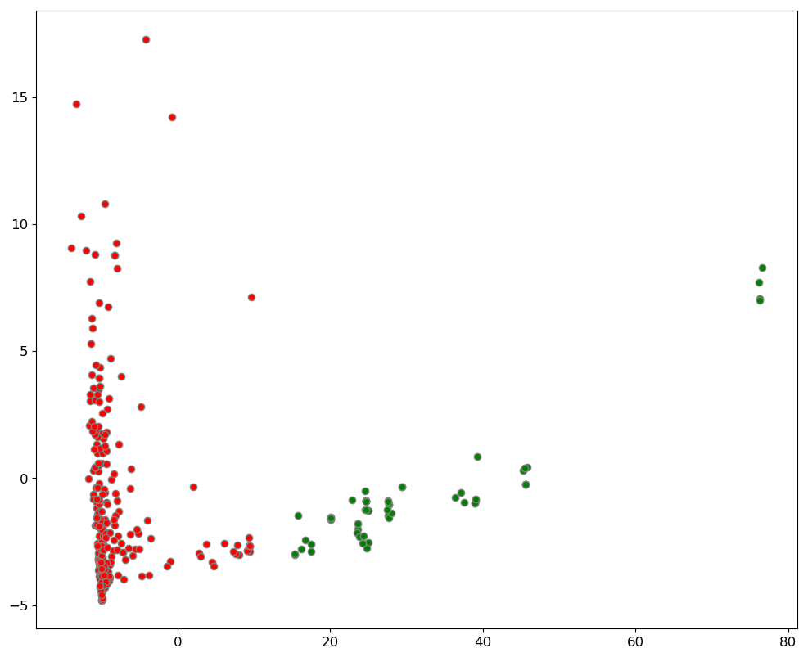
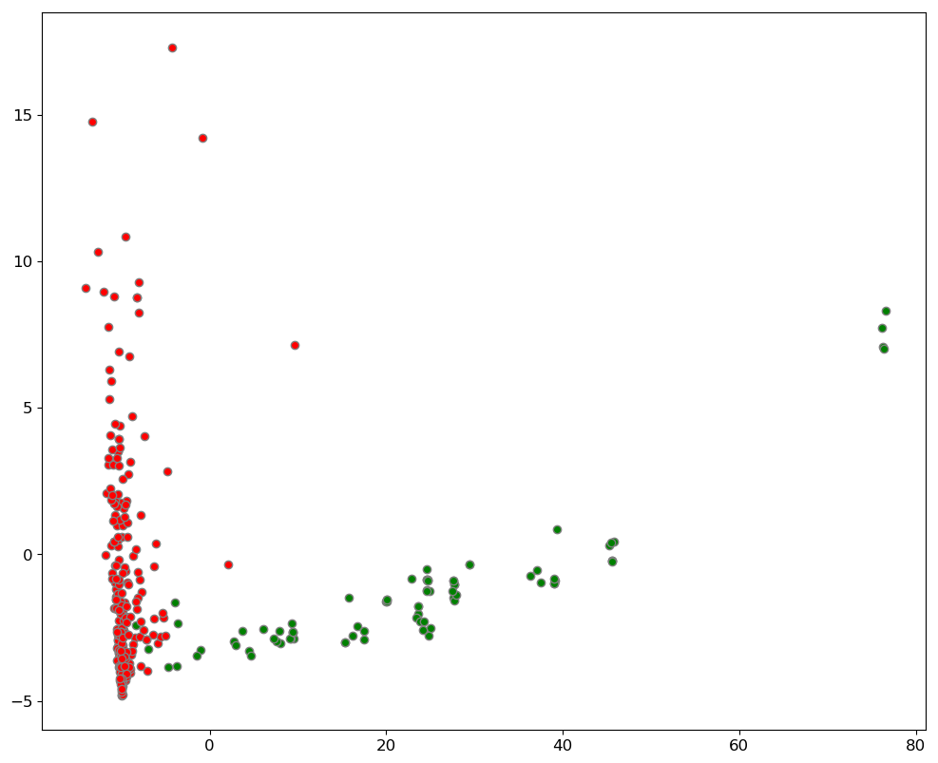
Cluster Analysis
Valid
Spam
Valid
Spam
K-Means
PCA
www.satprnews.com

Slide 14
Logistic Regression
Simple linear model for binary classification
Predicts probability of one class (e.g. Spam) over the other (Valid) for given X values, using the sigmoid function
Based on calculation of “odds” (probability of Class A / probability of Class B)
Features and their coefficients are linearly related to the “log-odds” (log of odds) of Class A

Slide 15
Hypothesis: Spam articles will have more exclamation points (!) than valid articles

Slide 16
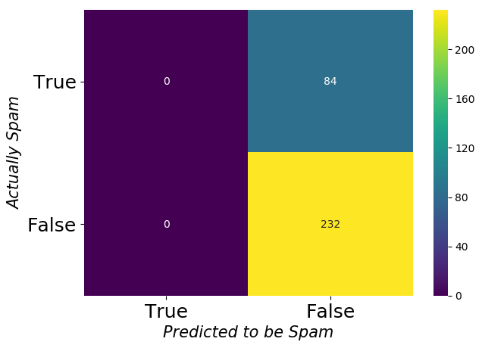
Logistic Regression Model of Exclamation Point Count
Accuracy: 73.4%
Precision: 0%
Recall: 0%
Coefficient for E.P. Count: -1.207
Odds: 0.3
The odds of an article being spam actually decrease ~3x for every additional exclamation point

Slide 17
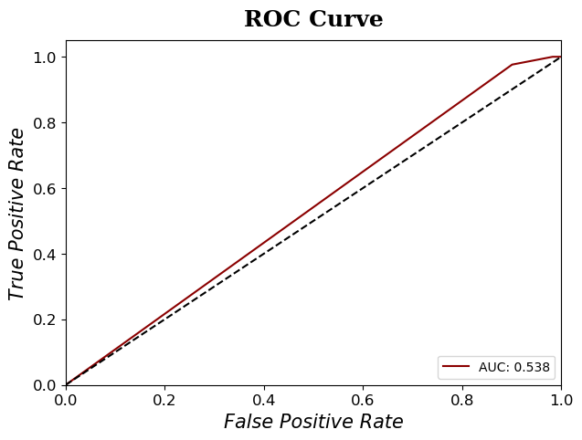
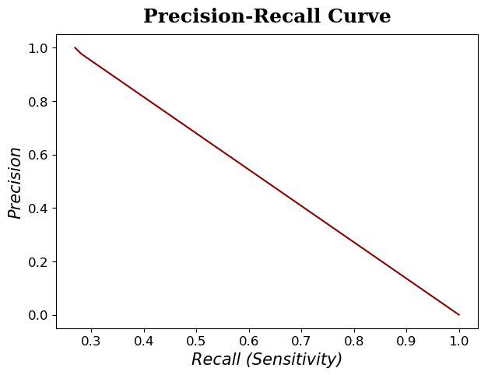
Logistic Regression Model of Exclamation Point Count

Slide 18
Hypothesis: Spam articles will have more embedded URLs than valid articles

Slide 19
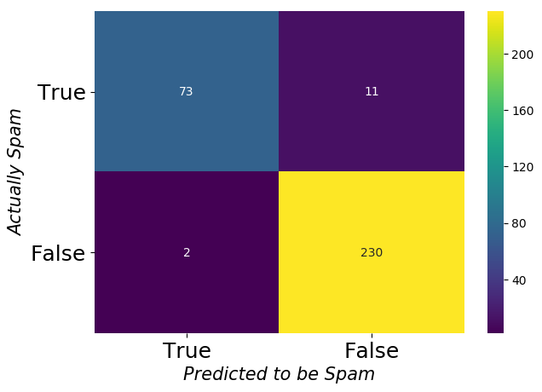
Logistic Regression Model of Exclamation Point Count
Accuracy: 95.9%
Precision: 97.3%
Recall: 86.9%
Coefficient for URL Count: 1.53
Odds: 4.62
The odds of an article being spam increase almost 5x for every additional URL present

Slide 20
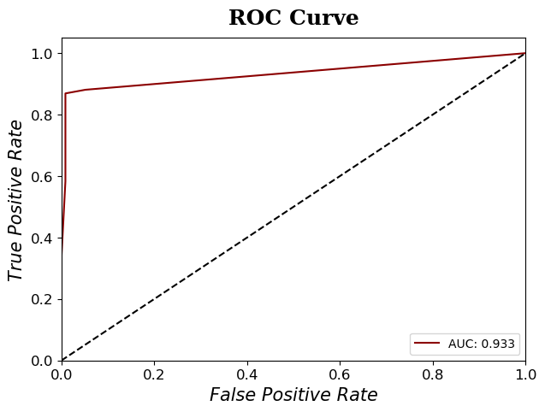
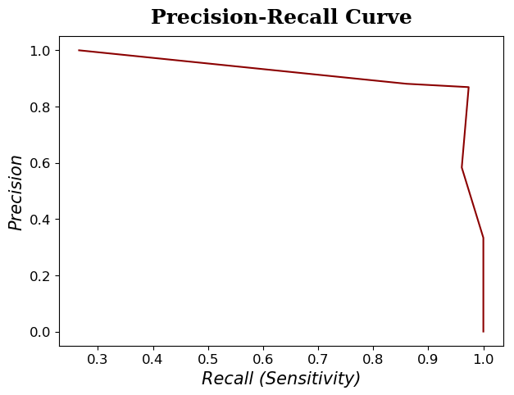
Logistic Regression Model of Exclamation Point Count

Slide 21
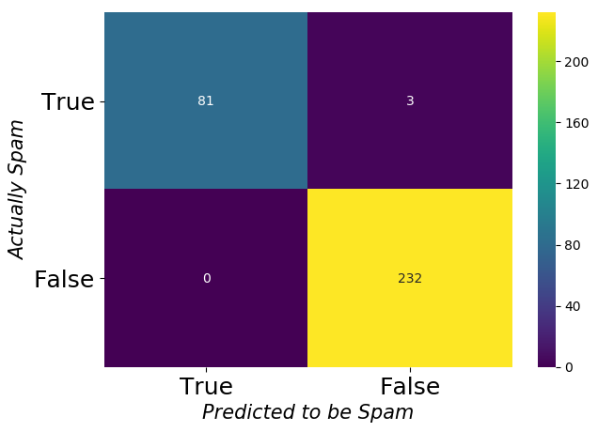
Logistic Regression Model with All Features
Accuracy: 99.1%
Precision: 100%
Recall: 96.4%

Slide 22
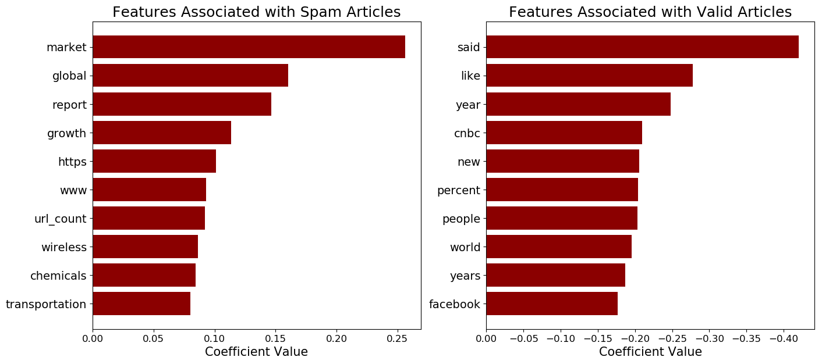

Slide 23
Naïve Bayes
Application of Bayes’ Theorem to classification context: estimates the conditional probability of an observation belonging to a particular class using the data and class distributions
Makes “naïve” assumption that all variables (here, words) are independent of each other for a given class (spam vs. valid)
Words here are expressed in counts, so we model them as coming from a multinomial distribution

Slide 24
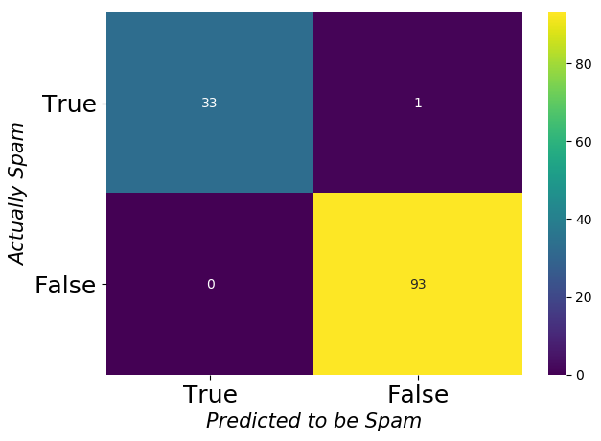
Naïve Bayes Model with 80-20 Train-Test Split
Accuracy: 99.2%
Precision: 100%
Recall: 97.1%

Slide 25
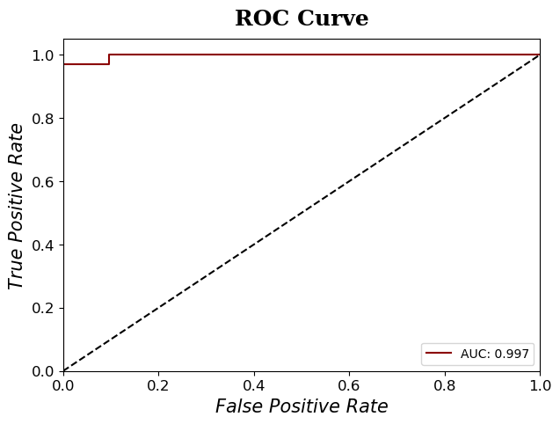
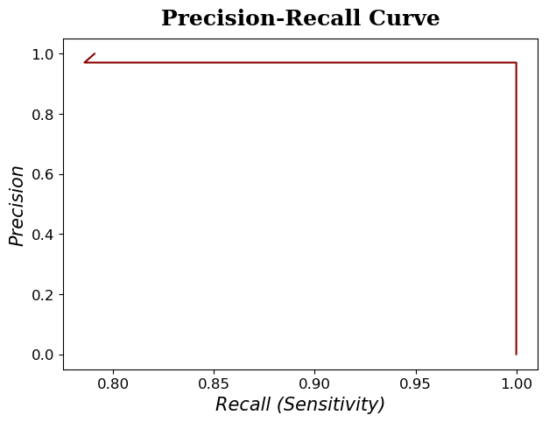
Naïve Bayes Model with 80-20 Train-Test Split

Slide 26
Incorrectly Classified Article:
PropertyUp, of Barrington, is excited to announce a new research tool to help buyers and sellers in Northern Illinois to get a feel for the real estate market. “Knowing when to buy or sell, and what to expect at any given time in real estate is important to having the most successful experience,” explained John Herman, broker/owner of PropertyUp. “We update figures monthly so that information is always current. When a change is coming, we can see the trends ahead of time.” Understanding the real estate market and how fast, or in some cases slowly, properties are selling is one of the keys to success for any buyer or seller. The new report shows at a glance whether the specific markets of Northern Illinois are favoring sellers, balanced, or favoring buyers. The information is relayed in easy to understand labels via a clickable map of the area. A click on any label will identify the specific market and define how many months supply of inventory is avaialble. The information is also displayed in an easy to navigate list, with an alphabetical selection for those that would rather see information laid out this way. In addition, the top 10 balanced, buyer’s and seller’s markets are identified in easy to read gauges. Buyer and seller reviews on their experiences working with PropertyUp are also available. This valuable information will help a potential seller know approximately how long they may have to wait for their home to sell, as well as what type of price they might get. A buyer can use the information to get an idea of the best place to search for a home with prices that may favor them, or where they are more likely to pay top dollar because of lacking inventory. PropertyUp is a full service residential and commercial real estate firm located in Barrington, Illinois, serving the Chicago area and Northern Illinois.

Slide 27

Naïve Bayes Model with 50-50 Train-Test Split
Accuracy: 98.7%
Precision: 98.8%
Recall: 96.4%

Slide 28
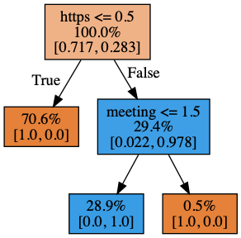
Random Forest
Ensemble method that combines the outputs of many decision trees for classification
Decision trees make a series of binary splits (using one feature at a time) to optimize the “purity” of the resulting groups with respect to class membership
The bottom nodes of each tree assign the observations to respective classes
Random forests randomize the samples and features used to build each tree

Slide 29

Random Forest Model
Accuracy: 99.7%
Precision: 100%
Recall: 98.8%

Slide 30
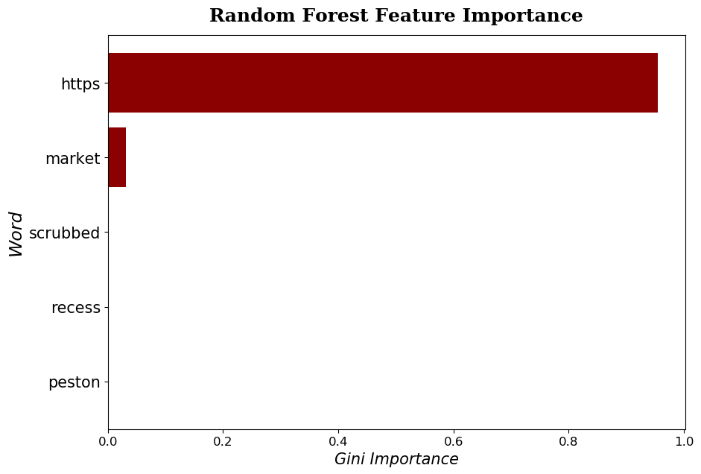

Slide 31
Conclusions
Spam articles can readily be detected and filtered using relatively simple linear or probabilistic classification models
Greater accuracy can be achieved using ensemble approaches at the expense of interpretability and speed
Spam articles are largely characterized by high numbers of embedded URLs and discussions of ”markets”, “growth”, and “reports” rather than recent news trends

